Slide 1
Reconstruction of latent tree models via spectral graph theory
Ariel Jaffe
Program in Applied Mathematics
Yale University
Joint work with:
Dr. Yariv Aizenbud, Mamie Wang, Noah Amsel, Amber Hu,
Prof. Joseph Chang, Prof. Yuval Kluger (Yale University)
Prof. Boaz Nadler (The Weizmann Institute)

Slide 2
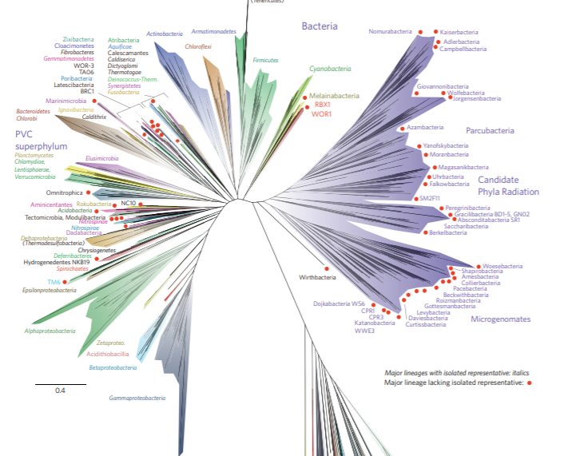

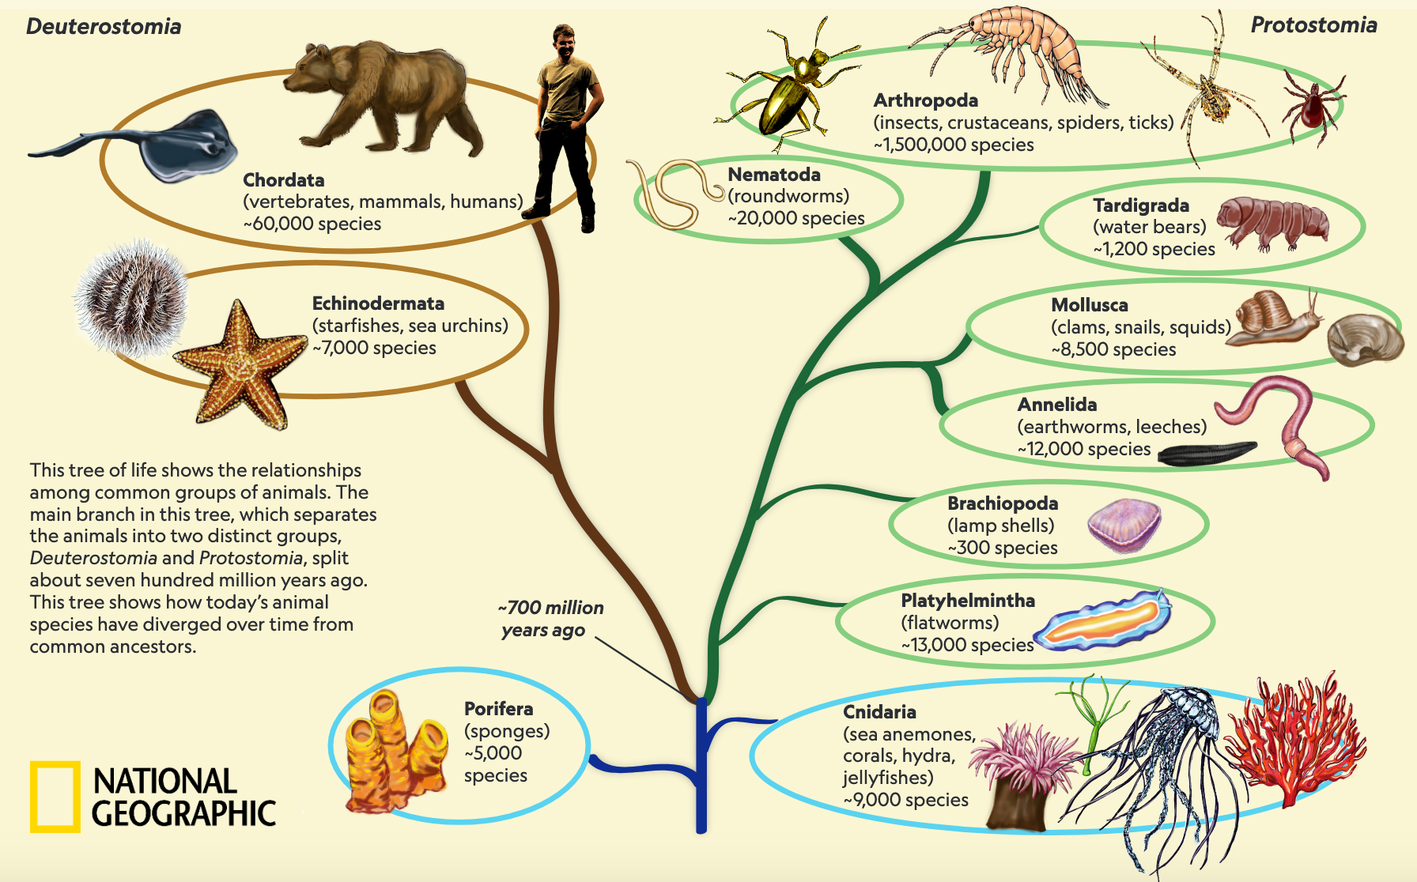
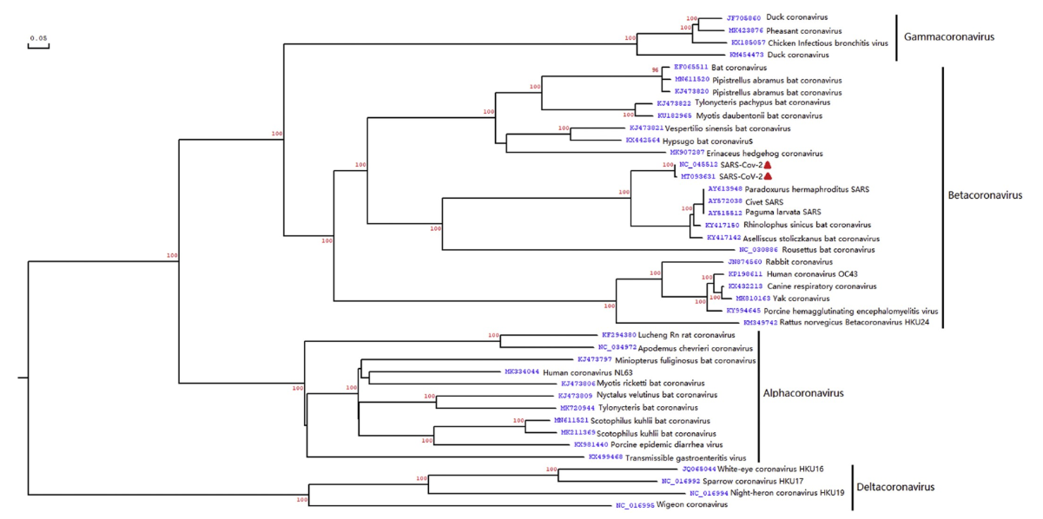

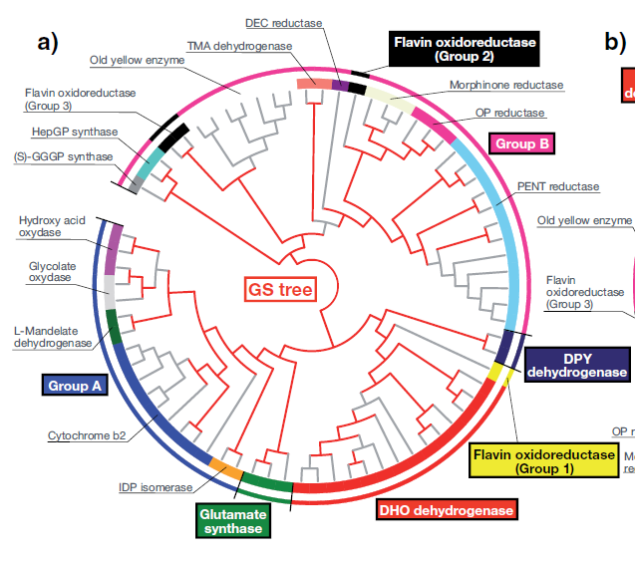
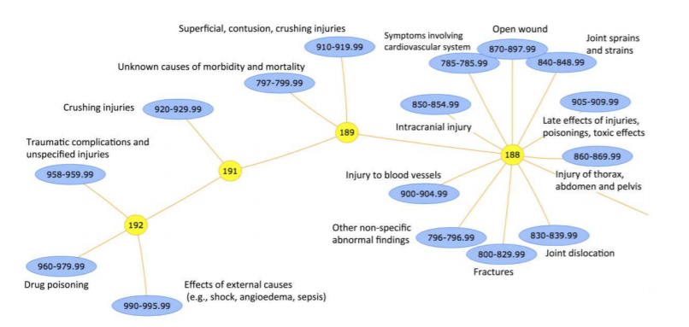
Recovering latent tree structures

Slide 3
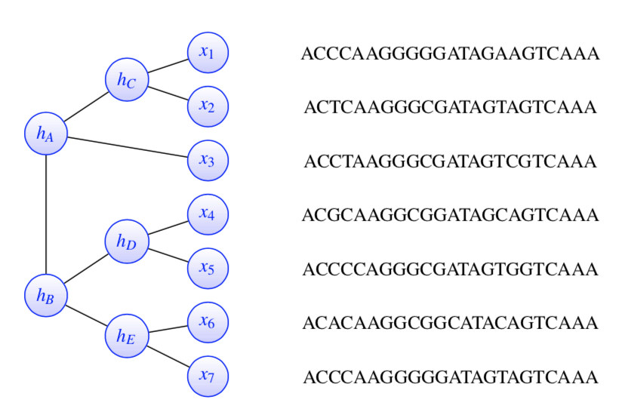


Problem Setup- binary tree model
{A,C,G,T}
$$P\left(h_{A} | h_{B}\right)$$
$$P\left(h_{B} | h_{A}\right)$$
$$0<δ≤|P\left(h_{A} | h_{B}\right)|≤ξ<1$$
Notes:
Describe assumptions on edge probabilities

Slide 4
A tree of tree recovery methods
Beast
Meta Trees
Divide & conquer
Bayesian /ML
Quartet Puzzling
FAST TREE
Distance based
Spectralmethods
RAxML
Tensor methods
UPGMA
NJ
Tree SVD
Recursive Grouping
STDR
SNJ

Slide 5
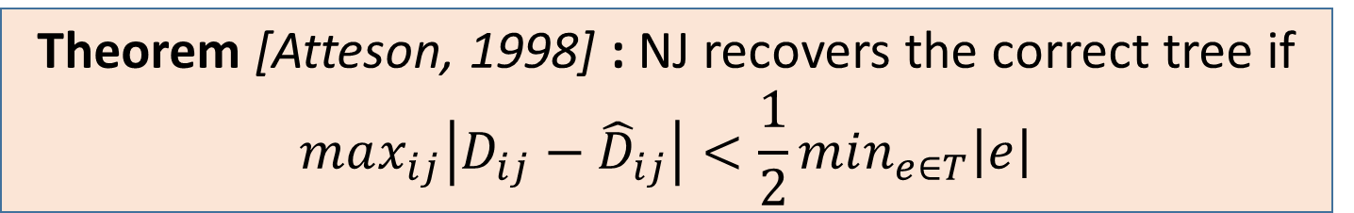
Distance based methods – main assumption
The observed measure of distance is additive along a tree
$$D\left(x_{1},x_{3}\right)=D\left(x_{1},h_{c}\right)+D\left(h_{c},h_{A}\right)+D\left(h_{A},x_{3}\right)$$
Example: the symmetric log-det distance
$$D\left(x_{1},x_{3}\right)=−\log{\det\left(P\left(x_{1} | x_{3}\right)P\left(x_{3}\right|x_{1})\right)}$$
Theorem [Chang, 1996] : Additivity is a sufficient condition for recovery of the tree
Theorem [Atteson, 1998] : NJ recovers the correct tree if
$$max_{ij}\left|D_{ij}−{\hat{D}}_{ij}\right|<\frac{1}{2}min_{e∈T}\left|e\right|$$
Notes:
Mention in a nutshell what NJ does

Slide 6
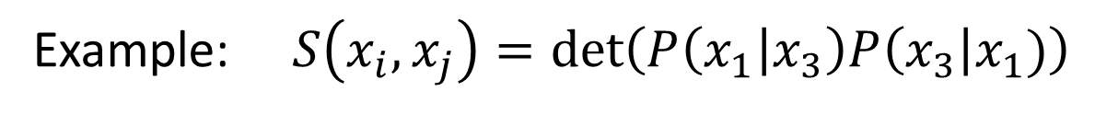

From distance to similarity
$$S\left(x_{i},x_{j}\right)=\exp\left(−D\left(x_{i},x_{j}\right)\right)$$
The observed measure of distance is multiplicative along a tree
Example: $S\left(x_{i},x_{j}\right)=\det\left(P\left(x_{1} | x_{3}\right)P\left(x_{3}\right|x_{1})\right)$
Notes:
Note – that there are much more sophisticated measures of distance.

Slide 7
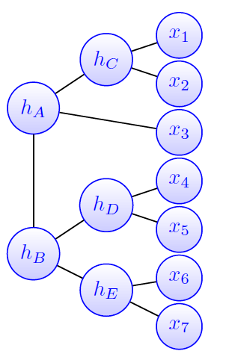
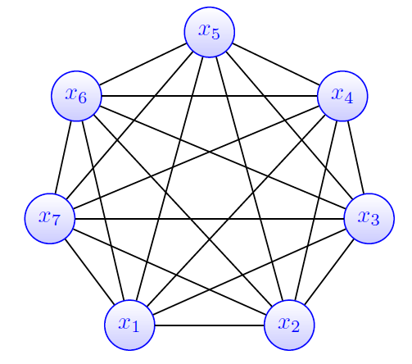
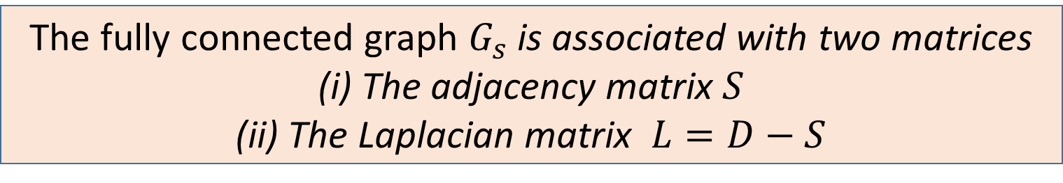

The similarity graph
$$S\left(x_{5},x_{6}\right)$$
Spectral Neighbor Joining (SNJ)
Jaffe et. al., SIMODS, 2020
Spectral Top Down Recovery (STDR)
Aizenbud, Jaffe et. al. , 2020
The fully connected graph $G_{s}$ is associated with two matrices
(i) The adjacency matrix $S$
(ii) The Laplacian matrix $L=D−S$
Notes:
Picture of tree vs. graph – talk about the adjacency matrix and Laplacian matrix –
One method is based on the adjacency and one on the Laplacian

Slide 8
Outline/main contributions
Part 1: Spectral neighbor joining (SNJ):
Key insight - the topology of the underlying tree is hidden in the similarity matrix
Theoretical comparison - when does SNJ improve upon NJ?
Part 2: Spectral top down recovery (STDR):
Key insight - spectral partitioning of the tree into disjoint parts
A novel Divide and conquer approach for recovering trees
Part 3: Recovery of continuous trees

Slide 9


























A clan: subset of nodes that can be disconnected by removing a single edge
Key insight: every clan in the tree corresponds to a rank one submatrix in $S$
$$x_{3}$$
$$x_{4}$$
$$x_{5}$$
$$x_{6}$$
$$x_{7}$$
$$h_{c}$$
$$h_{c}$$
$$x_{1}$$
$$x_{2}$$
$$x_{3}$$
$$x_{4}$$
$$x_{5}$$
$$x_{6}$$
$$x_{7}$$
$$x_{1}$$
$$x_{1}$$
$$S^{\left(1,2\right)}$$
$$x_{2}$$
$$x_{2}$$
$$x_{3}$$
$$x_{4}$$
$$σ_{2}\left(S^{1,2}\right)=0$$
$$x_{5}$$
$$σ_{2}\left({\hat{S}}^{1,2}\right)≈0$$
$$x_{6}$$
$$x_{7}$$

Slide 10















A clan: subset of trees that can be separated by removing a single edge
Our key insight: every clan in the tree corresponds to a rank one submatrix in $S$
$$x_{1}$$
$$x_{2}$$
$$x_{3}$$
$$x_{4}$$
$$x_{5}$$
$$x_{6}$$
$$x_{7}$$
$$x_{1}$$
$$x_{2}$$
$$x_{3}$$
$$σ_{2}\left(S^{1,4}\right)>0$$
$$x_{4}$$
$$x_{5}$$
$$x_{6}$$
$$x_{7}$$

Slide 11
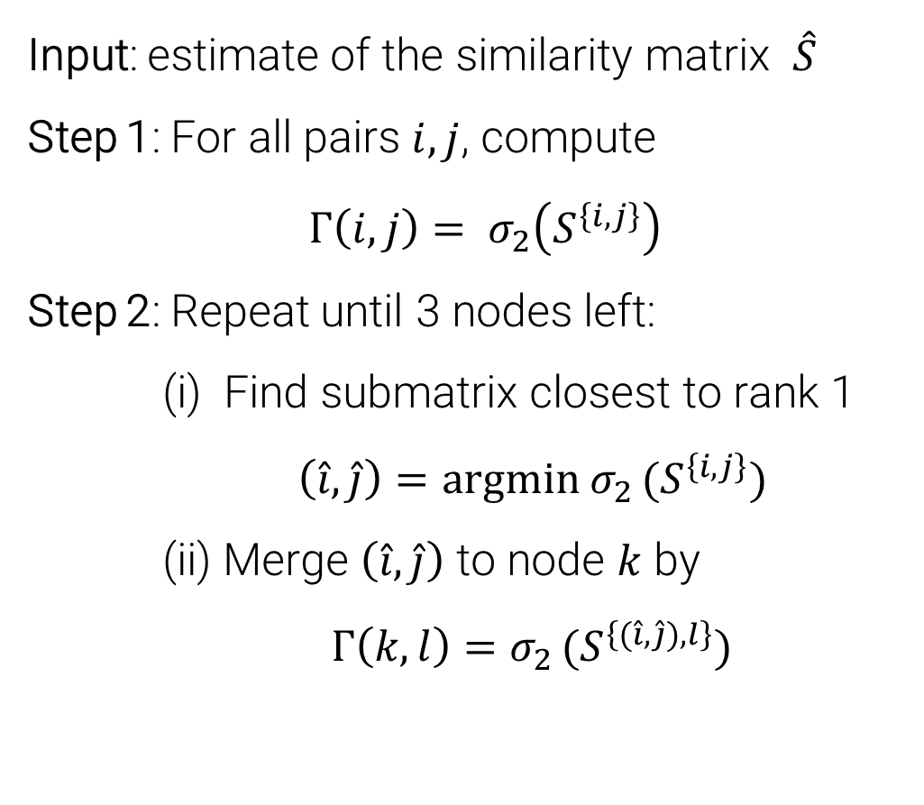
Spectral Neighbor Joining Algorithm
Input: estimate of the similarity matrix $\hat{S}$
Step 1: For all pairs $i,j$, compute
$Γ\left(i,j\right)= σ_{2}\left(S^{\left\{i,j\right\}}\right)$
Step 2: Repeat until 3 nodes left:
(i) Find submatrix closest to rank 1
$\left(\hat{i},\hat{j}\right)=argmin σ_{2 }(S^{\left\{i,j\right\}})$
(ii) Merge $\left(\hat{i},\hat{j}\right)$ to node $k$ by
$Γ\left(k,l\right)=σ_{2 }(S^{\left\{(\hat{i}, \hat{j}),l\right\}})$
$$x_{1}$$
$$x_{2}$$
$$x_{3}$$
$$x_{4}$$
$$x_{5}$$
$$x_{6}$$
$$x_{7}$$
$$x_{1}$$
$$x_{2}$$
$$x_{3}$$
$$x_{4}$$
$$x_{5}$$
$$x_{6}$$
$$x_{7}$$
$$x_{1}$$
$$x_{2}$$
$$x_{3}$$
$$x_{4}$$
11
$$x_{5}$$
$$x_{6}$$
$$x_{7}$$
$$x_{1}$$
$$x_{2}$$
$$x_{3}$$
$$x_{4}$$
$$x_{5}$$
$$x_{6}$$
$$x_{7}$$
11
Notes:
REMEMBER IT IS BOTTOM UP
Continue merging the pair of CLANS which have the lowest score
Cannot in practice go over all possible clans

Slide 12
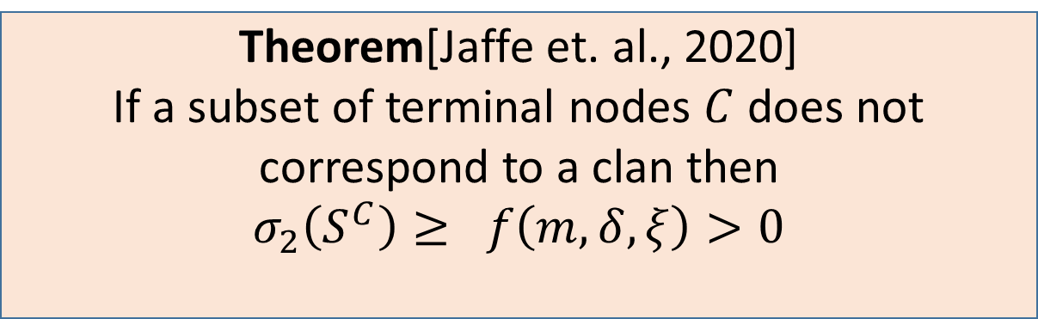
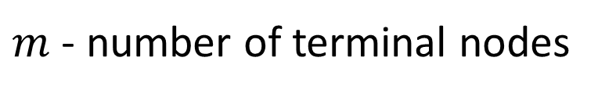
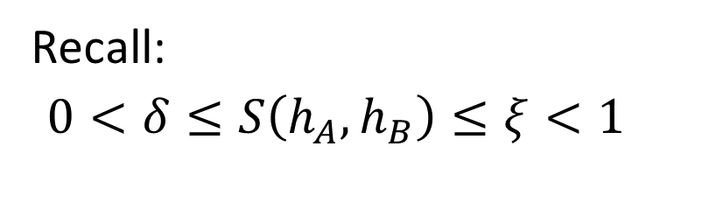
Consistency of SNJ:
Theorem[Jaffe et. al., 2020]
If a subset of terminal nodes $C$ does not correspond to a clan then
$σ_{2}\left(S^{C}\right)≥ f\left(m,δ,ξ\right)>0$
Recall:
$0<δ≤S\left(h_{A}, h_{B}\right)≤ξ<1$
$m$ - number of terminal nodes
Key insight: Given an exact similarity matrix $S$, SNJ recovers the exact tree
In practice, we can only compute a noisy estimate $\hat{S}$
Notes:
Sigma 2 is 0 for all correct clans and strictly greater than 0 otherwise
Discuss the formula:
As the delta goes to 0 or xi goes to one, the problem because harder.
This fits the formula because true clans are harder to tell apart
There’s NO dependency on the number of taxa unless delta is low
Delta 0.5 is like a mutation rate of 8% between adjacent nodes (which is pretty high!)

Slide 13
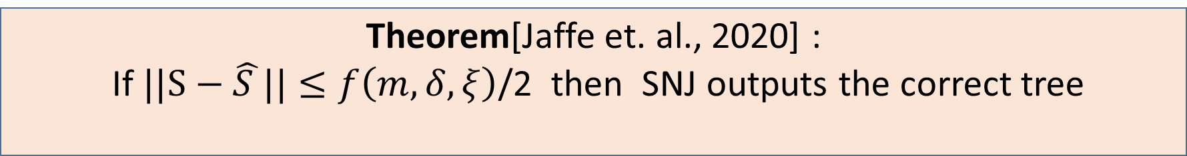
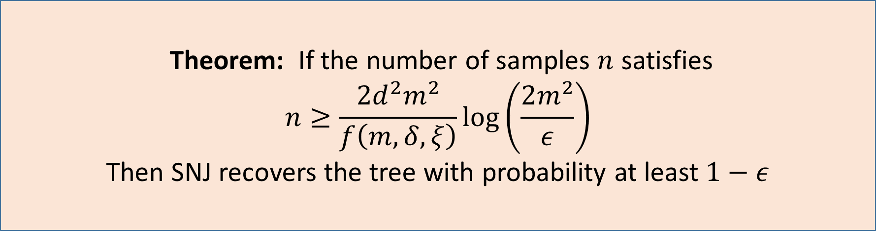
SNJ: Finite sample guarantees
Theorem[Jaffe et. al., 2020] :
If $||S−\hat{S }||≤f\left(m,δ,ξ\right)$/2 then SNJ outputs the correct tree
Theorem: If the number of samples $n$ satisfies
$$n≥\frac{{2d}^{2}m^{2}}{f\left(m,δ,ξ\right)}log\left(\frac{2m^{2}}{ε}\right)$$
Then SNJ recovers the tree with probability at least $1−ε$
Notes:
Call that curve f
Where S is the true similarity matrix (the one used to generate the data) and S bar is the estimate
REPLACE S IN THE PROOF WITH S HAT

Slide 14
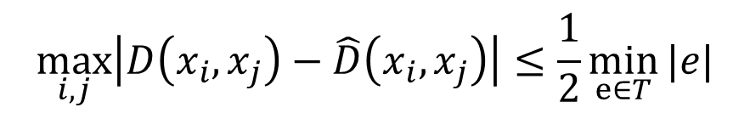



Neighbor Joining vs. Spectral NJ
NJ : Atteson’s theorem for accurate recovery
SNJ : Sufficient condition for tree recovery
$$\max_{i,j}\left|D\left(x_{i},x_{j}\right)−\hat{D}\left(x_{i},x_{j}\right)\right|≤\frac{1}{2}\min_{e∈T}{|e|}$$
$$||S−\hat{S}||≤\frac{1}{2}δ^{3}(1−ξ^{2})$$
Assumption: similarity between all adjacent nodes equal to $δ$
NJ: required accuracy of elements
in $\hat{S}$is order $δ^{diam(T)}$
SNJ: Required accuracy of
elements in $\hat{S}$is of order $1/$m
Notes:
Here, put the two guarantees,
If all edges are equal to delta, - compare

Slide 15
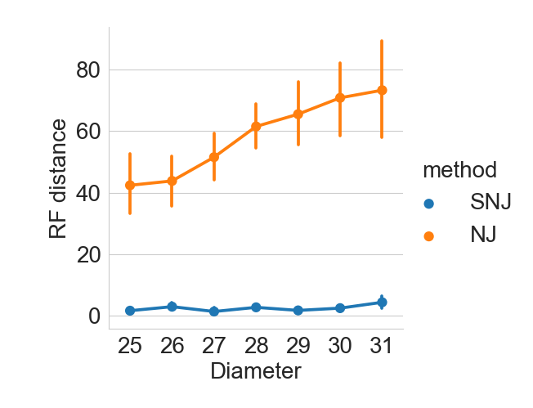
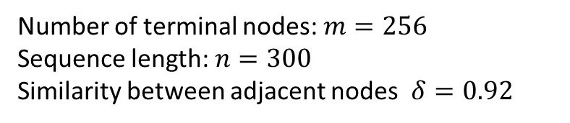
Results — random trees
Number of terminal nodes: $m=256$
Sequence length: $n=300$
Similarity between adjacent nodes $δ=0.92$

Slide 16
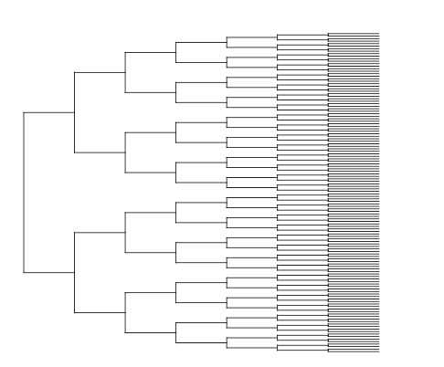
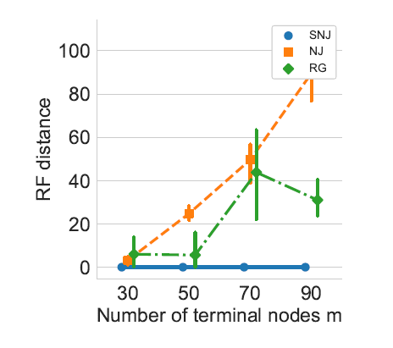
Symmetric binary trees
Sequence length $n=500$
$$diam\left(T\right)=2\log{m−1}$$
RG: Recursive Grouping [Choi et. al., 2012]
Notes:
Talk about the flow of the problem!!
Provide more data => similarity scores more accurate => performs better
This is hard! If p = 25%, even the closest pairs (two hops) are only 62% similar!
We’re plotting the probability that the method outputs a perfect tree — that means making 98 correct decisions in a row
You can get close to perfect with much fewer samples
HOW MANY TRIALS? > 30
Also you can see from the error bars that it’s pretty concentrated

Slide 17
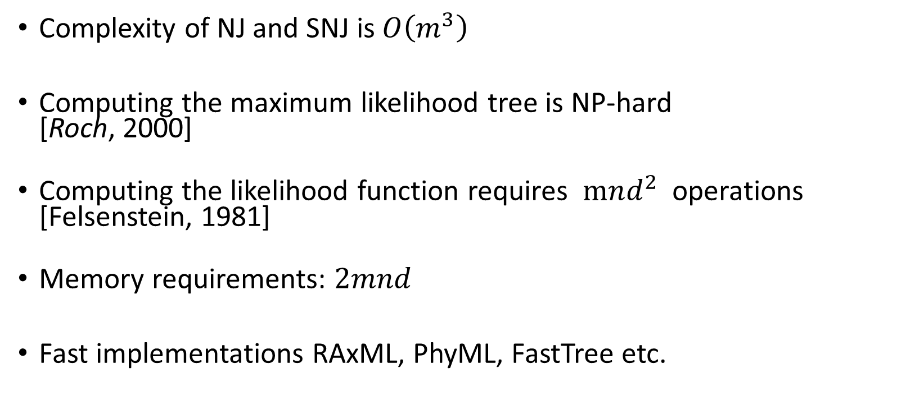
Limitations of existing methods
Can we compute trees with thousands of terminal nodes?
Complexity of NJ and SNJ is $O\left(m^{3}\right)$
Computing the maximum likelihood tree is NP-hard
[Roch, 2000]
Computing the likelihood function requires $mnd^{2}$operations
[Felsenstein, 1981]
Memory requirements: $2mnd$
Fast implementations RAxML, PhyML, FastTree etc.
Notes:
Gentle introduction to Maximum Likelihood!

Slide 18
Part 2: Divide and conquer
Main idea: recover the structure independently for small trees

Slide 19
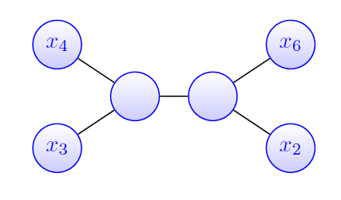
Divide and conquer
Merge the different trees by minimizing a consistency criterion
Example: number of small trees that are inconsistent with the large tree
Iterative methods: NJ merge [Molloy and Warnow, 2018]
DACTAL [Nelesen et. al. 2012]
Incremental tree building[Zhang et. al. , 2019]
Main problem: Optimizing over the maximum consistency criterion is NP hard [Hillis,1996, Jiang 2001]

Slide 20
Our contribution
A spectral approach for tree partitioning
Key point: The partitions correspond to disjoint subtrees
A spectral algorithm to merge disjoint subtrees
(A second) Key point: Merging the subtrees is no longer an NP hard probelm

Slide 21
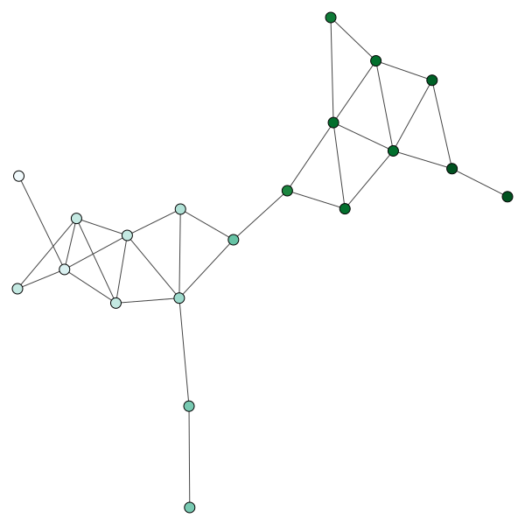
Fiedler’s theorem on nodal domains
The Fiedler vector: The eigenvector $ψ_{2}$ that corresponds to the second smallest eigenvalue of the graph Laplacian $L_{G}=D−W$.
Theorem [Fiedler, 1975] : The subgraph induced by a connected graph $G$ for the nodes $i$ such that $ψ_{2}\left(i\right)≥0$ is connected.
Notes:
Say why the trees are colored as they are colored. Say

Slide 22
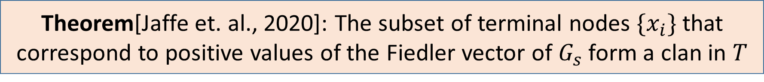
Fiedler’s theorem and latent tree models
Theorem[Jaffe et. al., 2020]: The subset of terminal nodes $\{x_{i}\}$that correspond to positive values of the Fiedler vector of $G_{s}$ form a clan in $T$

Slide 23
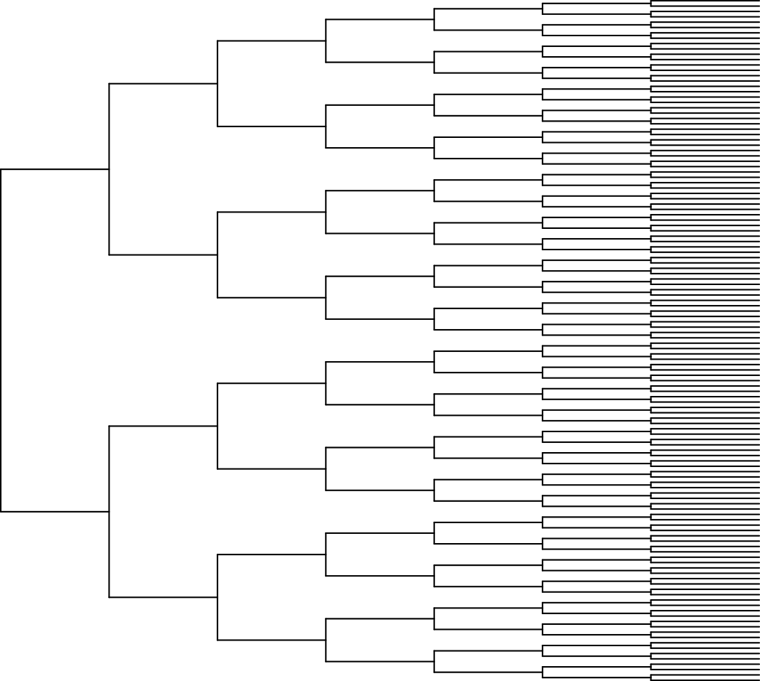
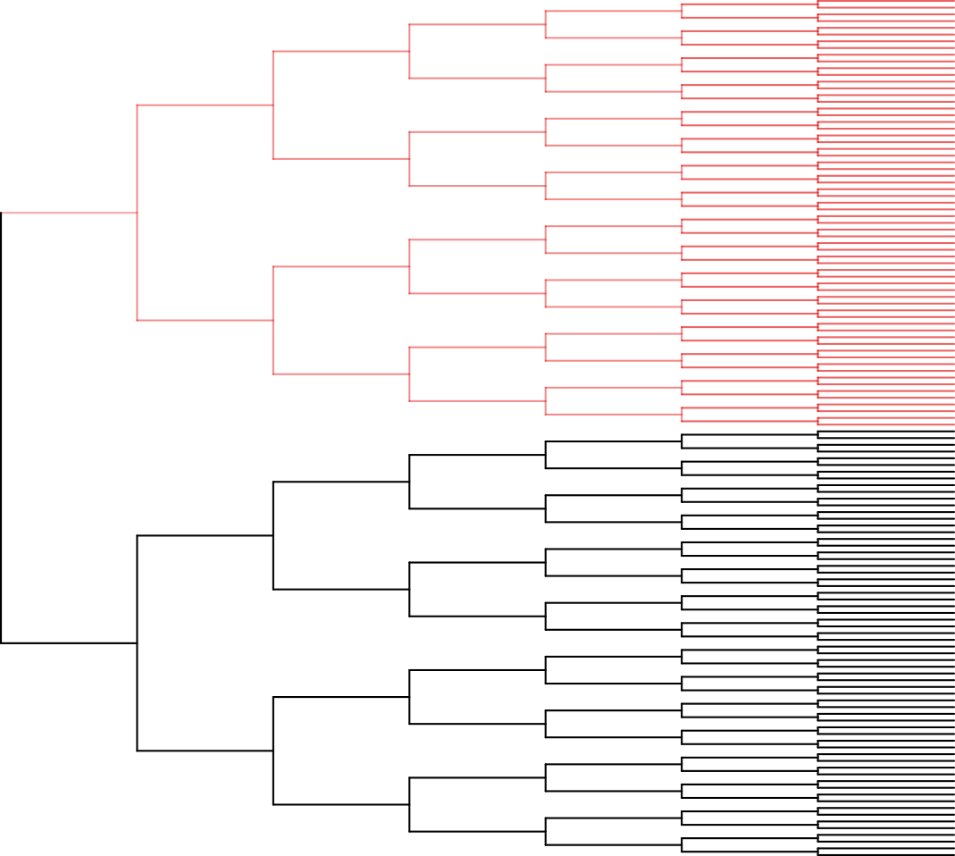
Example – binary symmetric tree

Slide 24
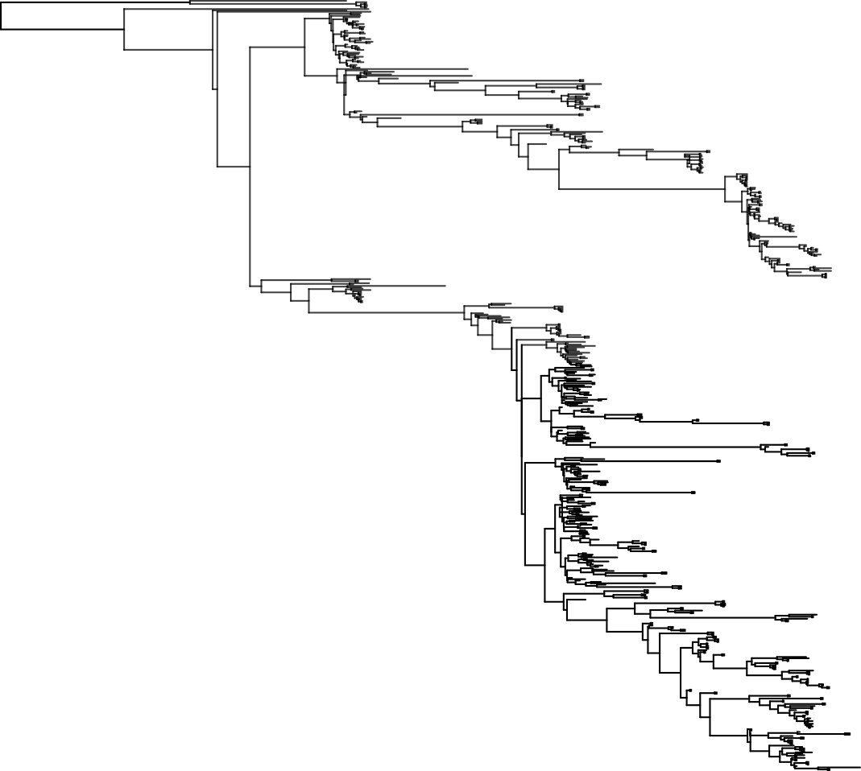
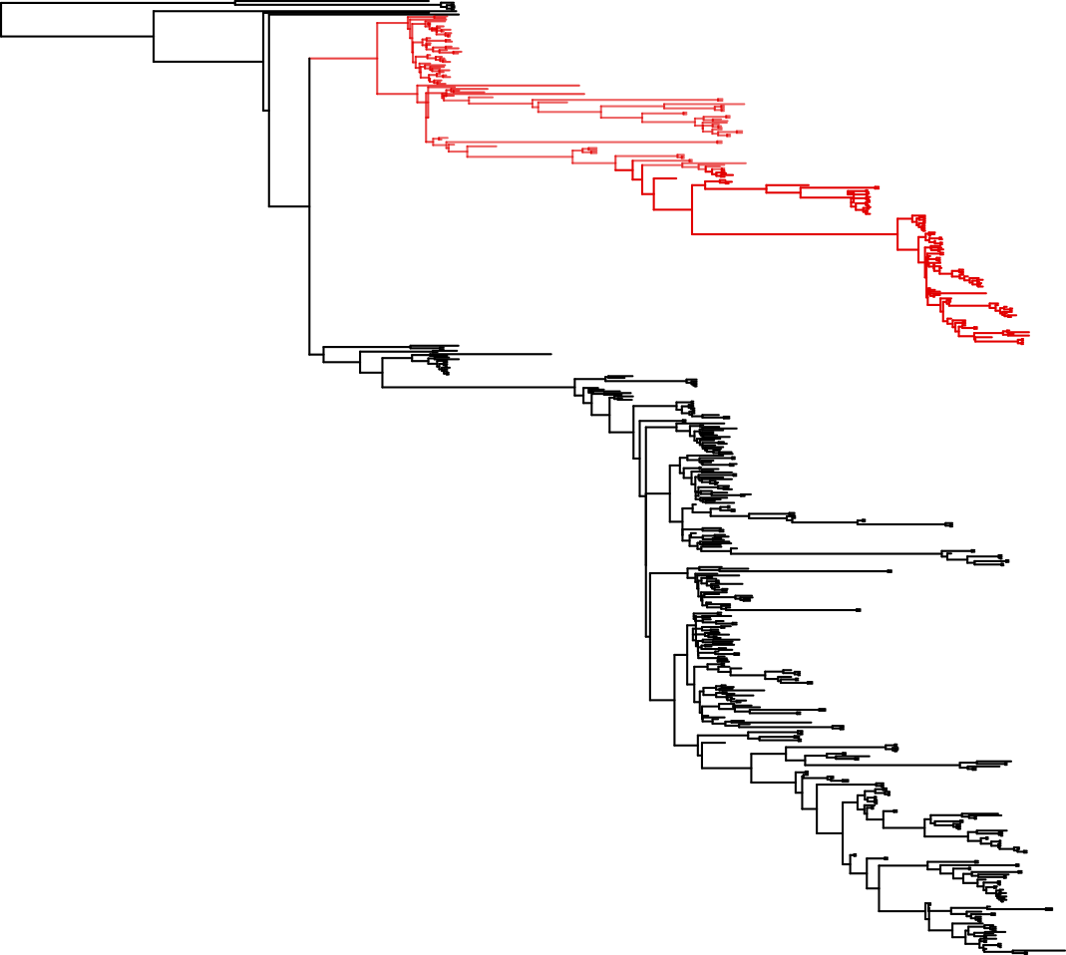
Example – New York H1N1 Influenza virus

Slide 25
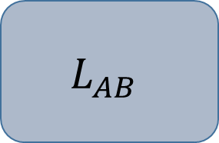






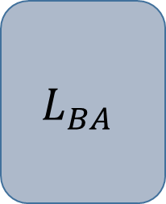
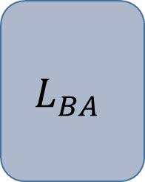
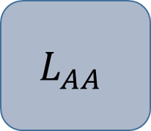
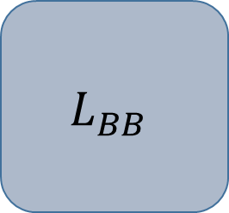
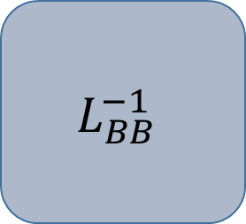
Effective resistance and Schur complement
$$L_{AA}$$
$$L_{AB}$$
The inverse of the weights computed by Schur complement are called effective resistance
$$V_{A}$$
$$L_{BA}$$
$$L_{BB}$$
Applications:
electrical networks [Dorfler et. al., 2012]
graph sparsification [Spielman et. al., 2011]
$$V_{B}$$
$$L_{AA}$$
$$L_{AB}$$
$$L_{BB}^{−1}$$
$$L_{BA}$$
$$\hat{L_{A}}=$$
$$−$$

Slide 26
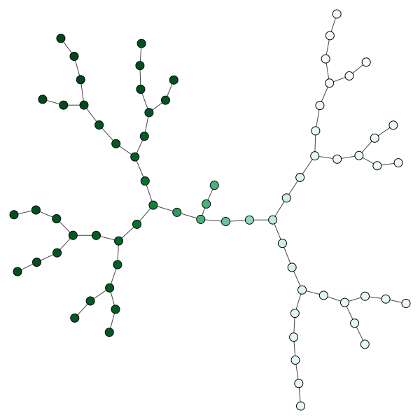
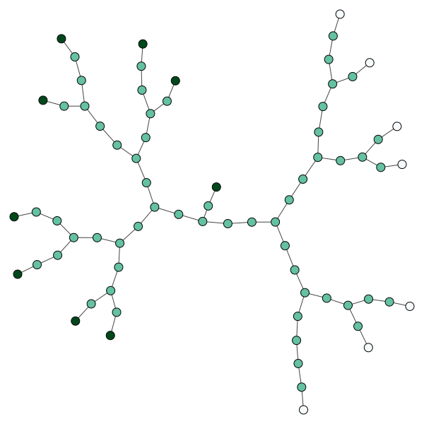
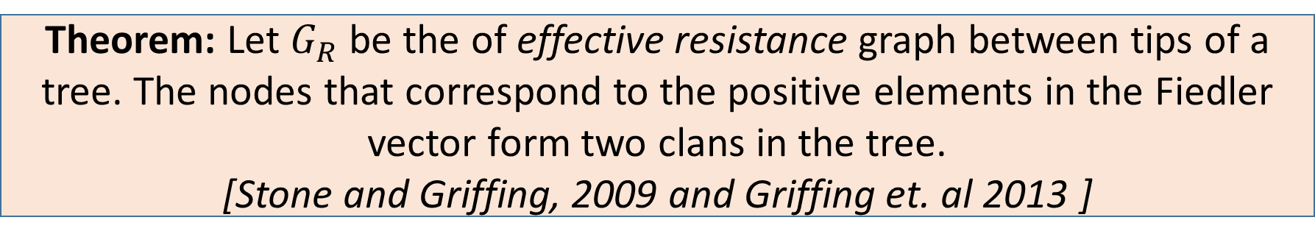
Schur complement on tree graphs
Taking the Schur complement of a tree Laplacian matrix with respect to all internal nodes, creates a fully connected graph defined over its tips
Theorem: Let $G_{R}$ be the of effective resistance graph between tips of a tree. The nodes that correspond to the positive elements in the Fiedler vector form two clans in the tree.
[Stone and Griffing, 2009 and Griffing et. al 2013 ]
Notes:
The problem is that we cannot directly estimate the effective resistance between terminal nodes

Slide 27
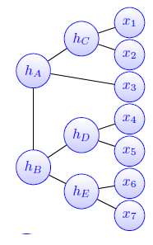
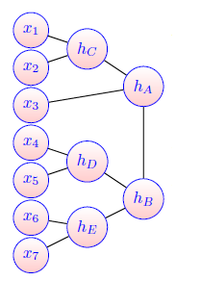
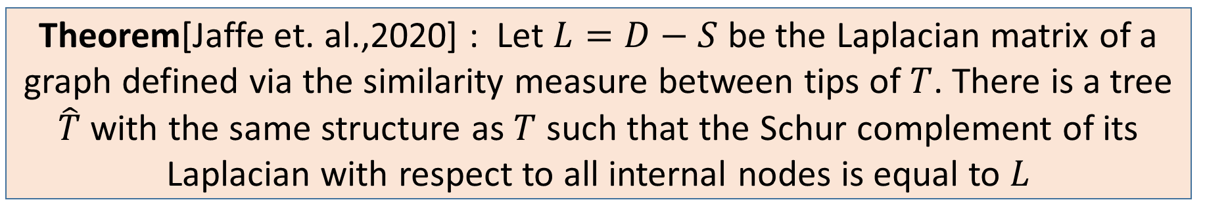
Relation between effective resistance and similarity
effective resistance
similarity
Theorem[Jaffe et. al.,2020] : Let $L=D−S$ be the Laplacian matrix of a graph defined via the similarity measure between tips of $T$. There is a tree $\hat{T}$ with the same structure as $T$ such that the Schur complement of its Laplacian with respect to all internal nodes is equal to $L$
Notes:
Here, state then

Slide 28
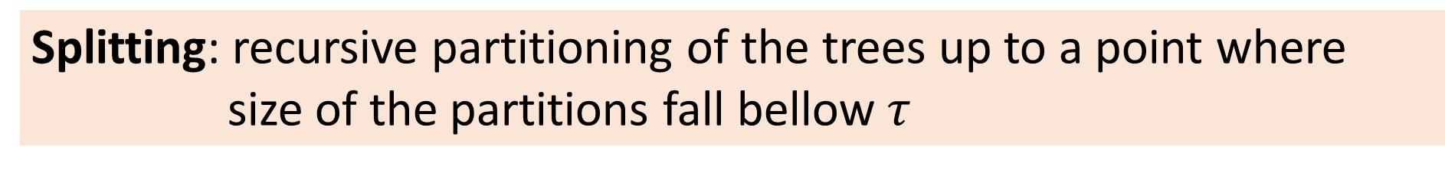
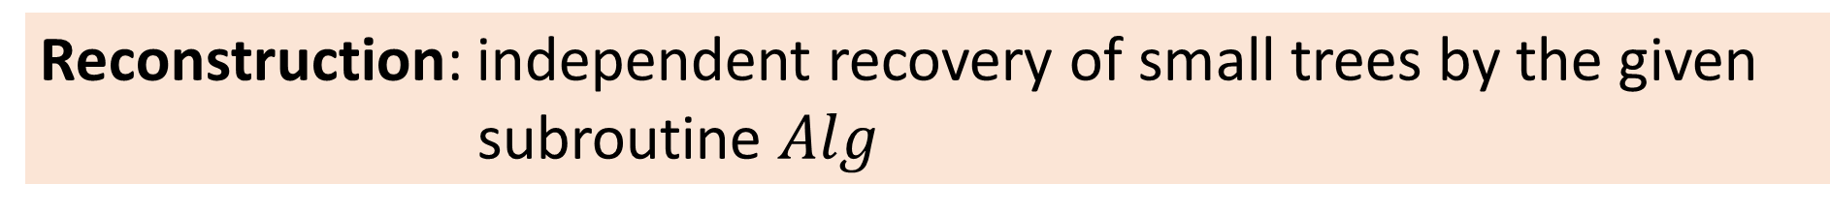
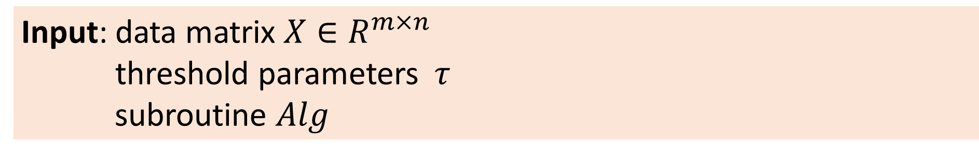
Spectral top down recovery
Input: data matrix $X∈R^{m×n}$
threshold parameters $τ$
subroutine $Alg$
Splitting: recursive partitioning of the trees up to a point where size of the partitions fall bellow $τ$
Reconstruction: independent recovery of small trees by the given subroutine $Alg$
Merging: merging the different subtrees to form the full tree
Notes:
The real gain of the splitting step – enable a merging process

Slide 29
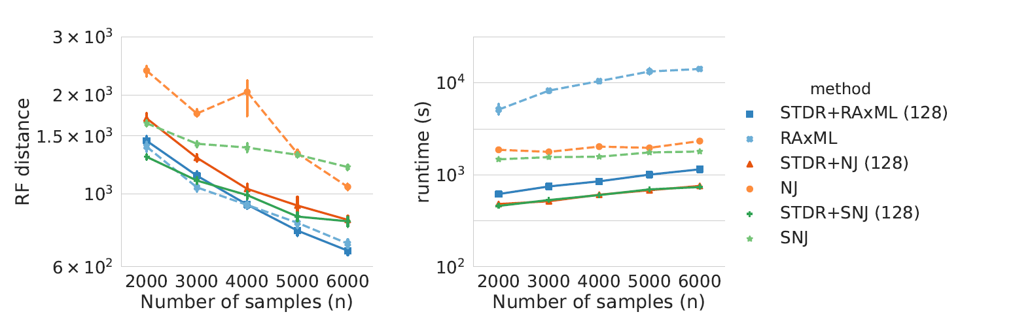

Example: the coalescent model
Number of nodes $m=2000$
Notes:
Don’t say seconds – 15 minutes instead of 4 hours

Slide 30






























































































Merging adjacent subtrees
Key insight: equivalent to rooting given multiple outgroups
$$h_{1}$$
$$h_{2}$$
$$h_{1}$$
$$h_{2}$$
$$h_{1}$$
$$h_{2}$$
$$h_{1}$$
$$h_{2}$$
$$h_{1}$$
$$h_{2}$$
$$h_{A}$$
$$h_{B}$$
$$h_{A}$$
$$h_{B}$$
$$h_{A}$$
$$h_{B}$$
$$h_{A}$$
$$h_{B}$$
$$h_{B}$$
$$x_{3}$$
$$h_{C}$$
$$h_{A}$$
$$h_{B}$$
$$h_{C}$$
$$h_{B}$$
$$x_{4}$$
$$h_{C}$$
$$h_{A}$$
$$h_{B}$$
$$h_{C}$$
$$x_{2}$$
$$h_{A}$$
$$h_{C}$$
$$x_{1}$$
$$h_{A}$$
$$h_{C}$$
$$x_{1}$$
$$x_{2}$$
$$x_{3}$$
$$x_{1}$$
$$x_{3}$$
$$x_{1}$$
$$x_{3}$$
$$x_{1}$$
$$x_{2}$$
$$x_{3}$$
$$x_{2}$$
$$x_{4}$$
$$x_{1}$$
$$x_{2}$$
$$x_{3}$$
$$x_{2}$$
$$x_{4}$$
$$x_{4}$$
$$x_{5}$$
$$x_{6}$$
$$x_{7}$$
$$x_{4}$$
$$x_{5}$$
$$x_{6}$$
$$x_{7}$$
$$x_{4}$$
$$x_{5}$$
$$x_{6}$$
$$x_{7}$$
$$x_{5}$$
$$x_{6}$$
$$x_{7}$$
$$h_{A}$$
$$x_{5}$$
$$x_{6}$$
$$x_{7}$$
$$h_{A}$$
$$x_{1}$$
$$x_{4}$$
$$x_{3}$$
$$x_{5}$$
$$x_{6}$$
$$x_{7}$$
$$x_{3}$$
$$x_{1}$$
$$x_{2}$$
$$x_{2}$$
$$x_{4}$$
$$h_{B}$$
$$h_{B}$$
$$x_{3}$$
$$x_{4}$$
$$x_{3}$$
$$x_{4}$$
$$x_{1}$$
$$x_{2}$$
$$x_{1}$$
$$x_{2}$$

Slide 31
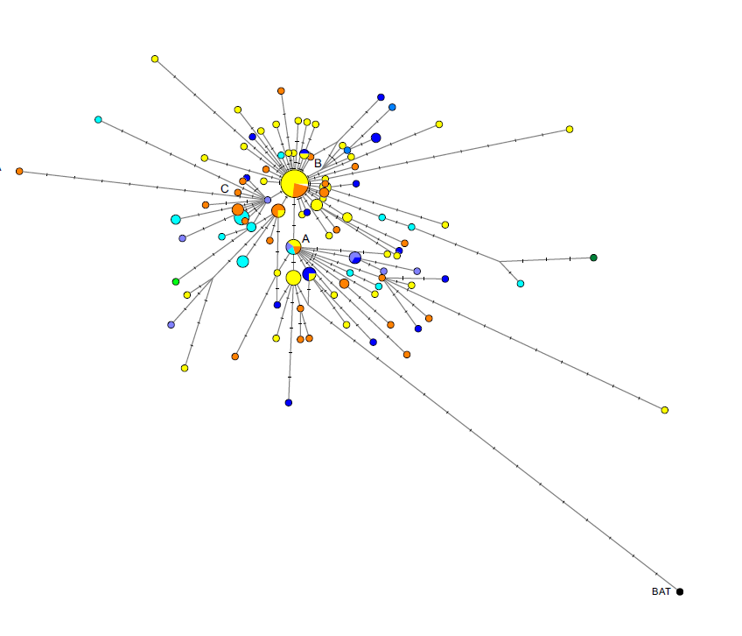
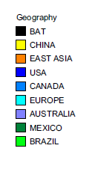
Finding a root using an outgroup
Original paper: Forster et. al., 2020
Replies: Mavian et. al., 2020
Sánchez-Pacheco et. al., 2020
Chookajorn, 2020

Slide 32




Back to the adjacency matrix
$$A$$
$$S(A,B)$$
$$B$$
Edge merging score: $d\left(e\right)=\frac{1}{||S\left(A,B\right)|| }\min_{α} ||αv_{A}v_{B} −S(A,B)||$
Notes:
Computational Complexity

Slide 33

Part 3:– continuous trees
Theorem: Let $ψ_{2}$ be the Fiedler vector of a tree and let $e(i,j)$ be an edge
That satisfies $ψ\left(i\right)ψ\left(j\right)≤0$. The values of the Fiedler vector over any path that includes $e(i,j)$ is monotonic [Fiedler, 1975]
[Gernandt and Pade,2019]
[Lederman and Steinerberger, 2020]

Slide 34



Increasing resolution of high dimensional data

Slide 35
Thank you

